Slide 1
UI for Free Fall Penetrometers
Members: Brett Dupont, Rayya Burns, Vincent Ciccotelli, Anthony Snider, Troy Ciardelli-Zaryckyj, Stephen Fallon

Slide 2
Overview

Slide 3
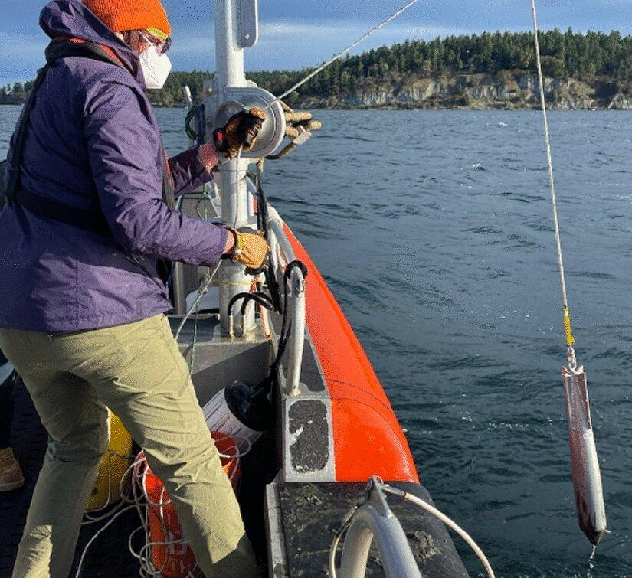
Why?
Soil characterization of the ocean floor is an expensive and difficult task
Free Fall Penetrometers are small devices used to aid in this classification
Dropped from boats, they can estimate various parameters about the soil
The data they generate is raw and needs to be processed and analyzed
Existing systems to process this data are disparate and not user friendly

Slide 4
Vision
MOV
Continue adding to the Free Fall Penetrometer user interface, implementing relative density calculations, pore pressure properties, and overall improvements to increase UX
Within one academic year, the desktop application is refactored and built upon to incorporate the calculation of two relative density calculations, expansion of soil classification, friction angle calculation, and pore pressure properties

Slide 5
Success Criteria
Take input and accurately output the relative density calculations
Improve UI to ease navigation and use
Utilize relative density calculations for soil classifications

Slide 6

Stakeholders
Project Owner
Julie Paprocki
Project Advisor
Lisa Henry
Development Team
Brett Dupont
Rayya Burns
Vincent Ciccotelli
Anthony Snider
Troy Ciardelli-Zaryckyj
Stephen Fallon
Users
Emma Dennis

Slide 7
Requirements

Slide 8
Requirements
Functional
Allow the user to choose the directory where the generated PNG figure will be saved
Automatically create a new, well-labeled folder for all CSV files generated for each new figure
Drop points can be selected from visualized data
Graphs generated for important data analytics (drop points, spike, etc.)
Graphs created have clearly defined labels
Relative density calculations are correct and displayed
Non-Functional
Intuitive user experience
Only valid inputs are processed
Time from user input to data output should be under three seconds
Need scalable process speeds and data visualization for growing input data sizes
Visual output should show desired data clearly

Slide 9
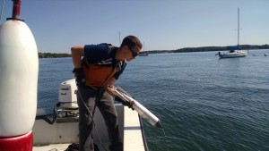
User Stories
OE Researcher/Grad Student
Wants a simple and quick to use system
Preferably avoid manual work (e.g. spreadsheets)
As an OE Researcher, I want a simple unified code base so that I can focus on analytics rather than data pipelines
As an OE Researcher, I want to have a bug-free experience when navigating the application
As an OE Researcher, I want the generated data from each figure to be saved to well labeled and easy to find folders or personally choose where the data is saved

Slide 10
User Stories
Researcher (cont.)
As an OE Researcher, I want to calculate relative density using the Albatal formula to use in other operations of the application
As an OE Researcher, I want to calculate relative density using the White et al. formula to use in other operations of the application.
As an OE Researcher, I want to input relative density parameters which would be used for plots

Slide 11
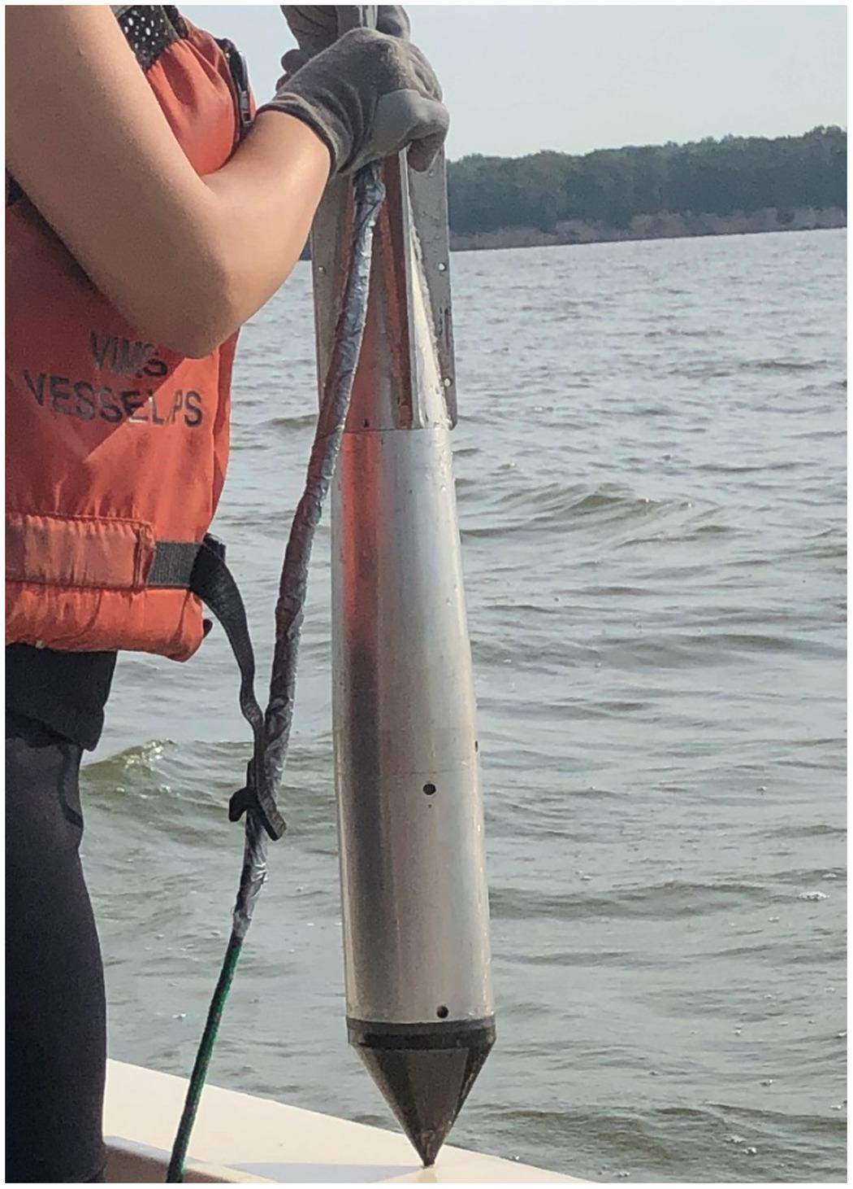
User Stories
Administrator
Technical experience, but not that of a developer
Wants an expandable system
As an Administrator, I want the software to be well documented and adaptable so that future developers can easily understand and improve it
As an Administrator, I want to be able to add more data processing modules so that this tool can be updated in the future
As an Administrator, I want the relative density formulas to be scalable and easily updateable so that new formulas can be added

Slide 12
Design
Notes:
Now leading into the design of the system, I’ll show you an architecture diagram and some sequence diagrams describing user interactions with the system

Slide 13
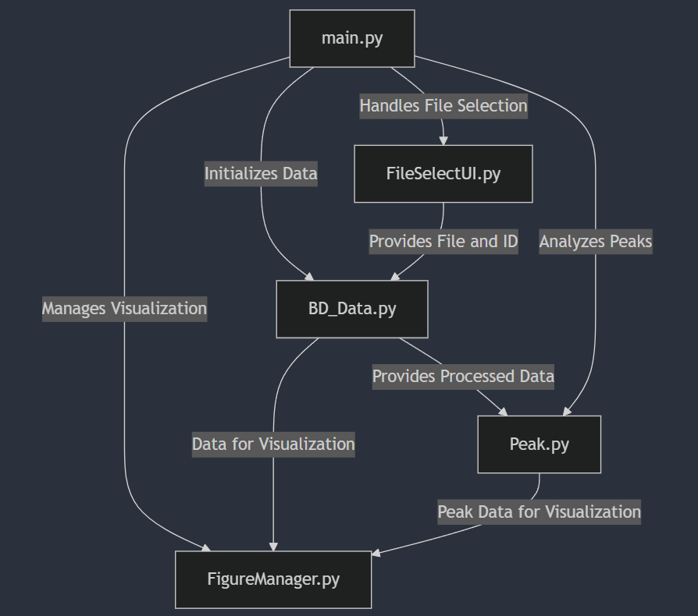
Architecture Diagram
Main:
Initializes FileSelectUI, Figure Manager
Directs the flow of the program
Handles user inputs
FileSelectUI:
Allows user to upload a .bin data file from desktop and select the BlueDrop ID associated with the data
FigureManager:
Singleton-like figure to display data when needed
BD_Data:
Represents a .bin data file associated with a BlueDrop ID to store accelerometer and pressure data
Peak:
Cropped version of BD_Data to perform specific calculations
Notes:
Here is our Architecture Diagram for the system. As you can see, we have 5 main portions split up into different python scripts and classes, each serving their own purpose. main.py is the director - it initializes UI components and

Slide 14
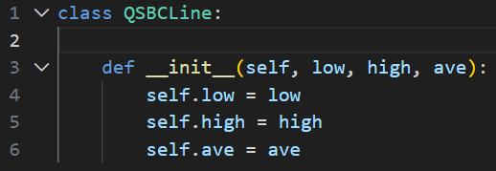
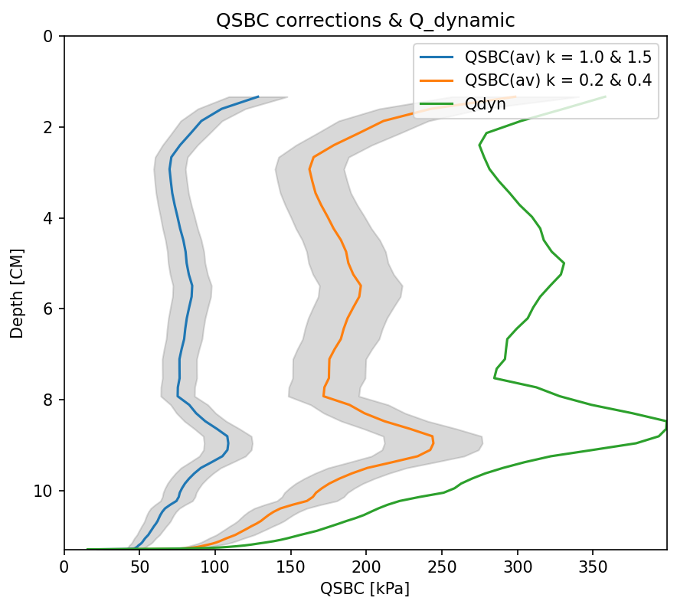
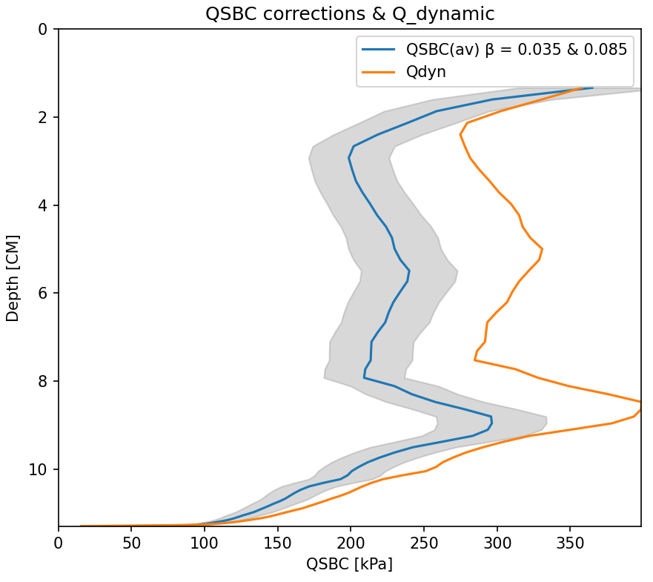
Architecture Improvements
Not all correction factors are supposed to produce two QSBC lines
Original code passed in each array of values for a line
New code uses a QSBCLine class and passes in a list of these objects to the display function

Slide 15
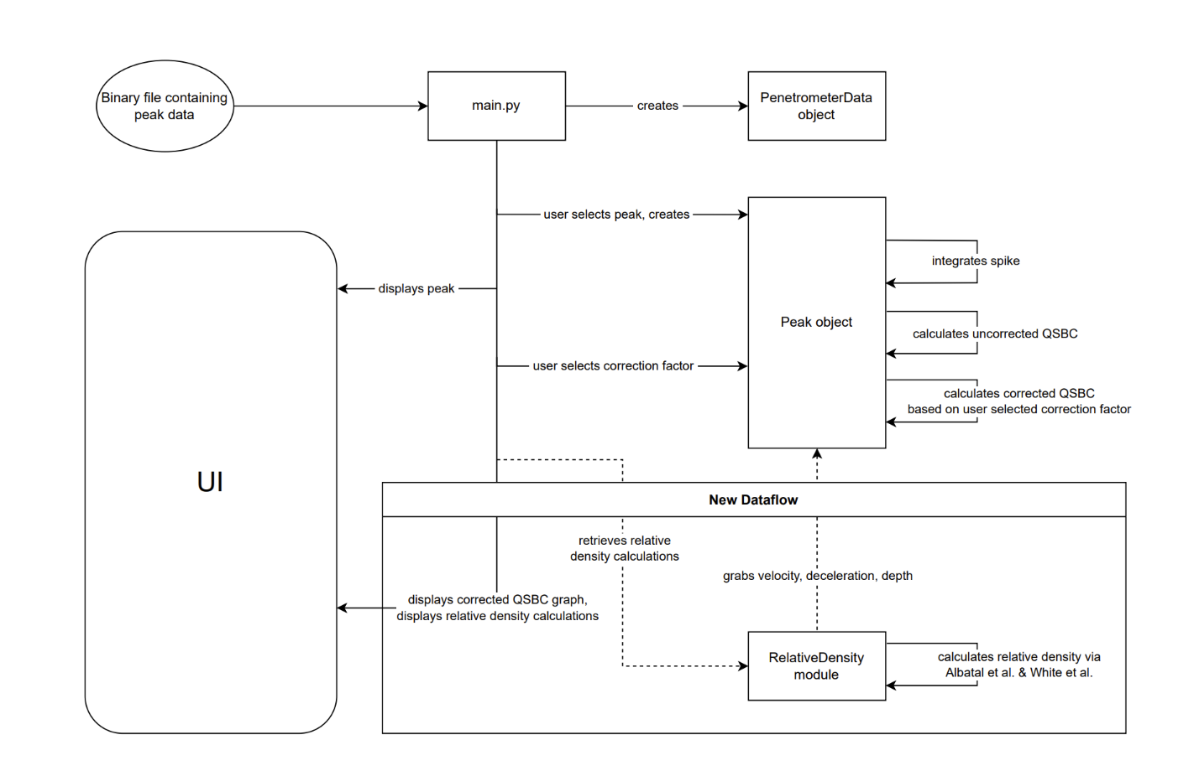

Slide 16
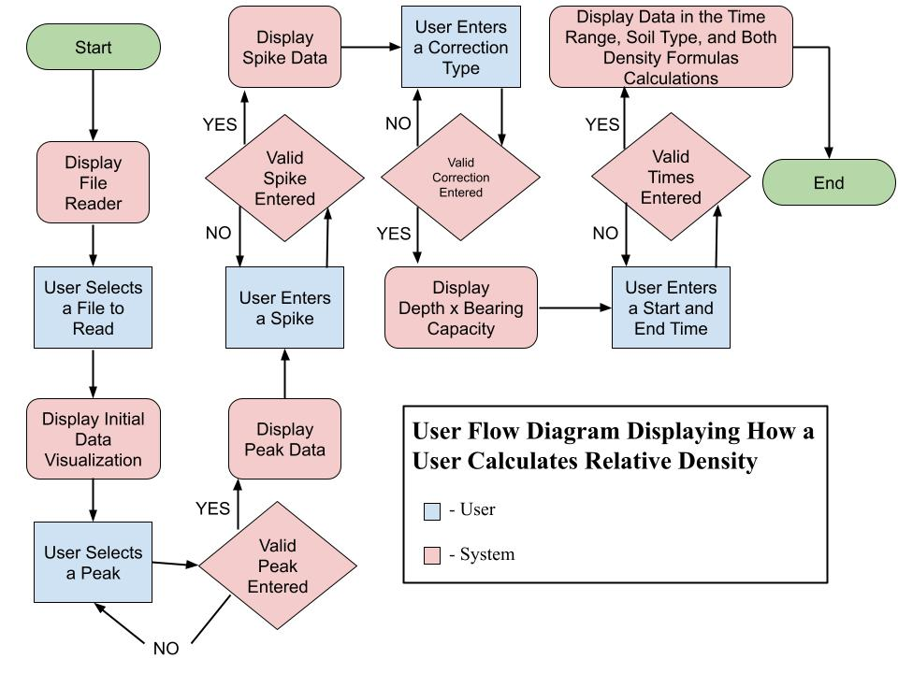

Slide 17
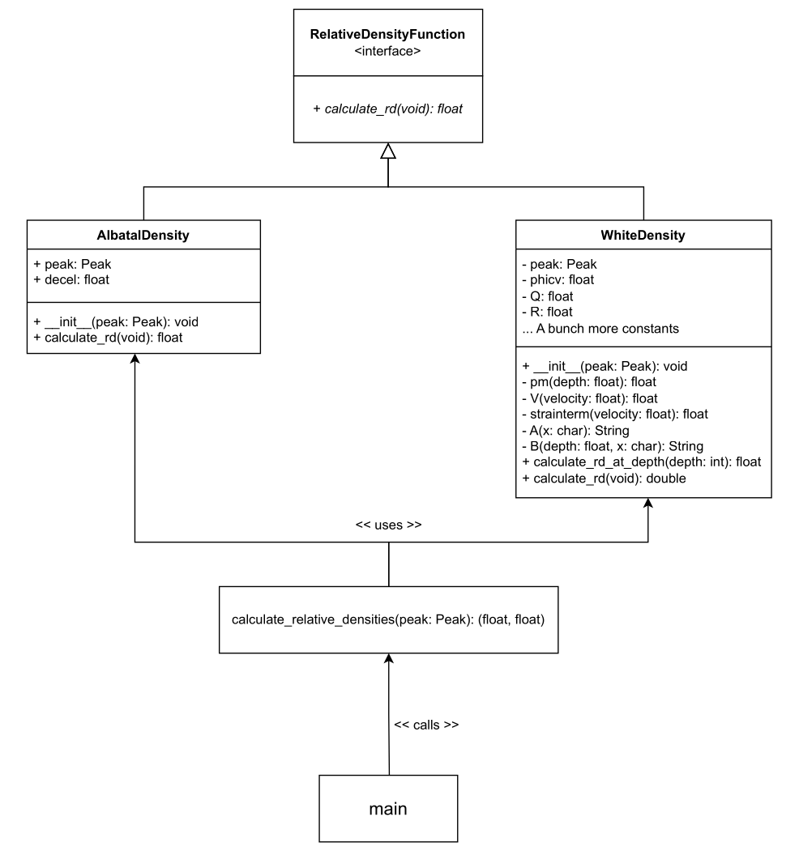
Relative Density Implementation
AlbatalDensity and WhiteDensity implement the two eponymous relative density formulas.
The Albatal formula is much simpler, easier to implement
The White formula is significantly more complex and involved, took far more work to implement
calculate_relative_densities returns a pair of floats, with the first float obtained through the usage of AlbatalDensity, and the second through WhiteDensity.
Main makes use of this pair of floats to pass to the required display functions

Slide 18


Relative Density Implementation
calculate_relative_densities
calculate_relative_densities usage (main)
*we only want to calculate relative densities if the soil we are looking at is a sand
albatal_density & white_density are then passed to the necessary display functions in order to display the densities to the user

Slide 19
Implementation & Testing

Slide 20
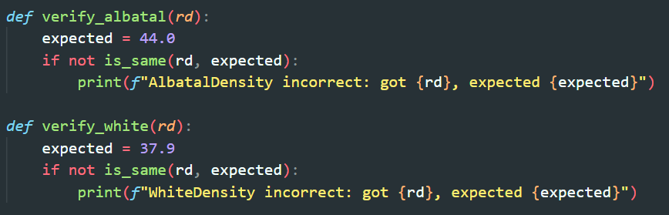

Relative Density Tests
Our current testing structure consists of two keys files: (verify.py) and (test.py)
verify.py contains multiple small functions that check whether your computed results:
(deceleration, velocity, depth, area, QSBC, pore pressure, densities, etc.) match the expected known-correct values.
test.py just runs the full pipeline, it loads the data, computes the peak, and then computes all the outputs the values and then calls the verify functions from verify.py one by one.

Slide 21


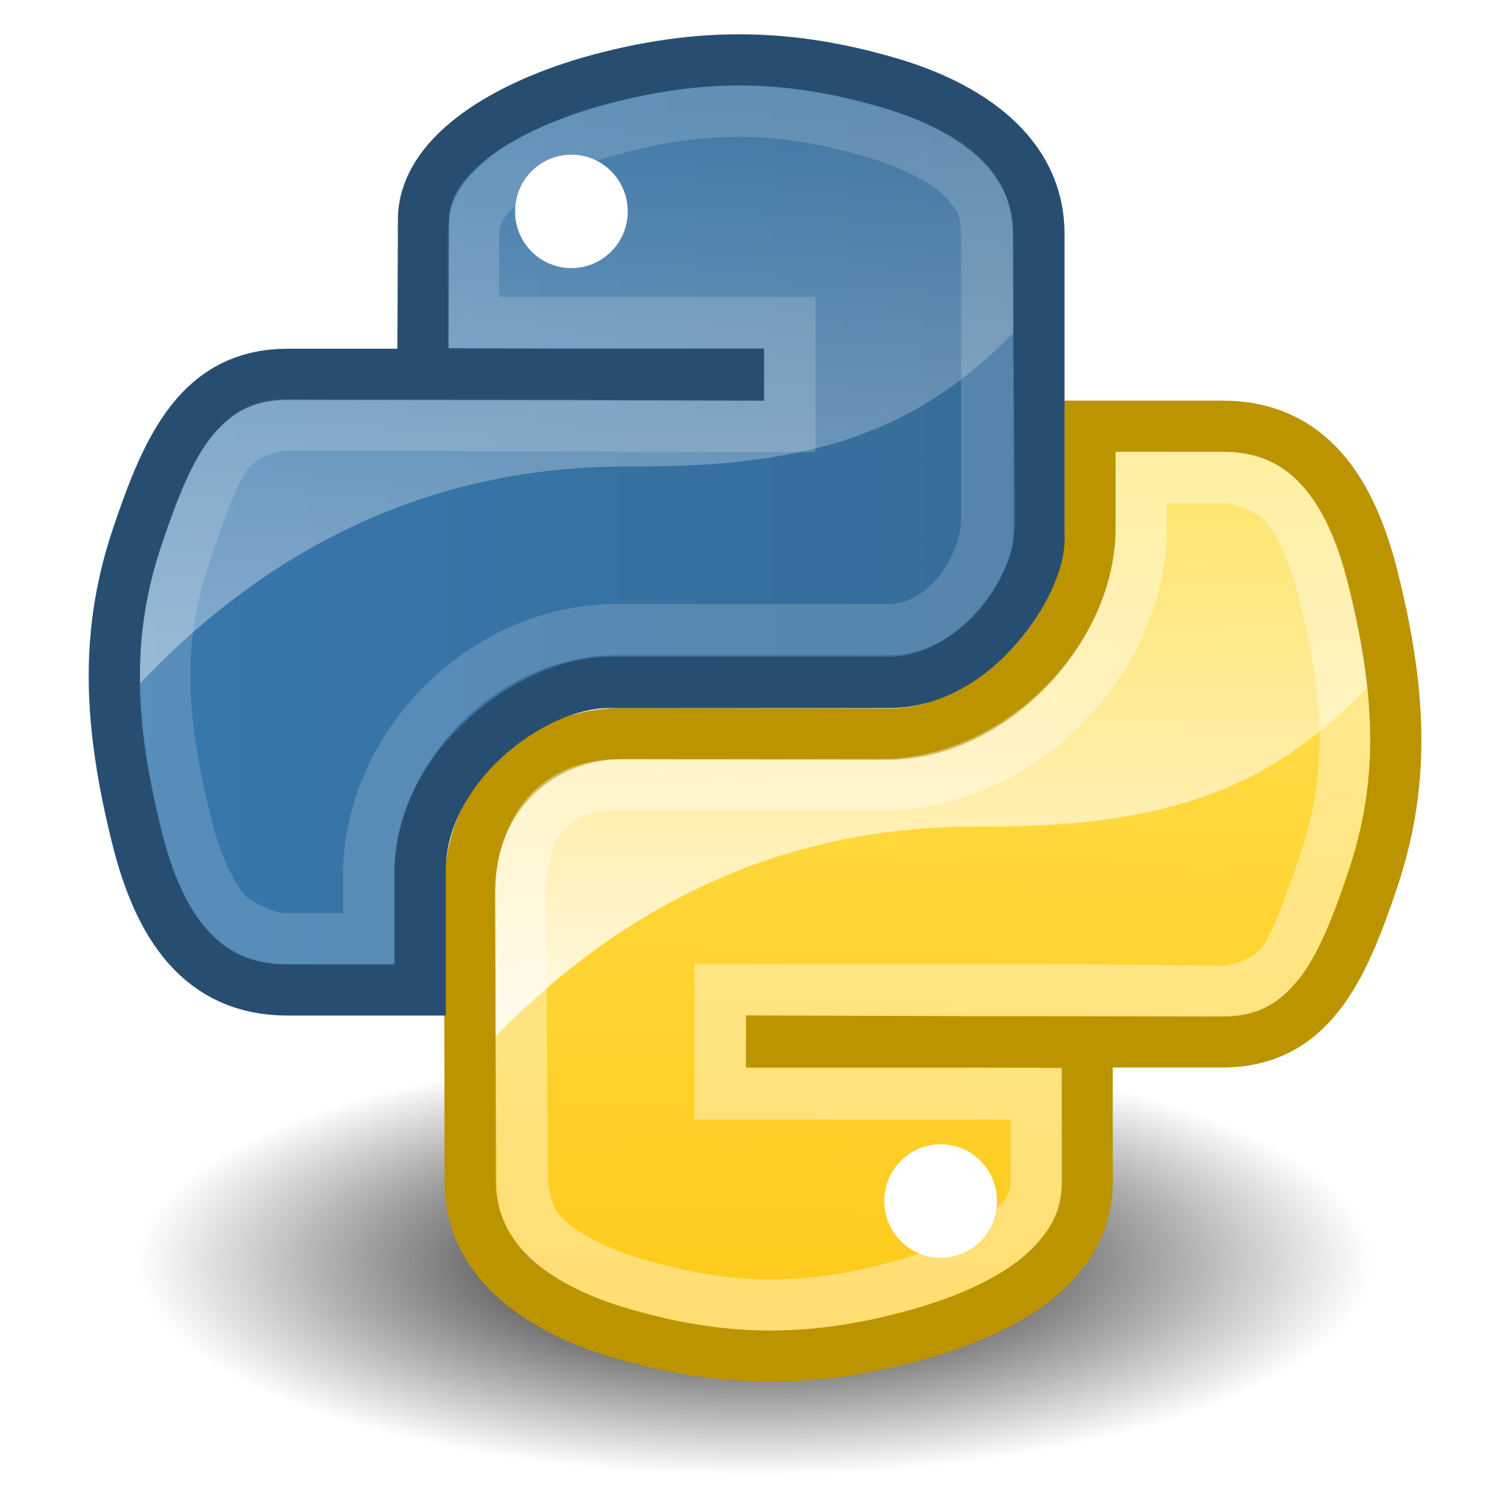

Tools
Using Python 3.10.x or newer
Python Packages:
Matplotlib: Data Visualization
NumPy: Efficient Computation
SciPy: Scientific Computing Tools
Tkinter: GUI Framework
os
math

Slide 22
Testing & Result Validation
Conducted direct comparisons between MATLAB and Python implementations
Verified MATLAB workspace variables (1-based indexing) align with NumPy arrays (0-based indexing)
Ensured MATLAB plots closely resemble Matplotlib visualizations
Researched MATLAB and NumPy/SciPy documentation to confirm that functions had identical operations.
Validated that array outputs are numerically identical between the two platforms
Confirmed results directly with the project sponsor

Slide 23
Demo

Slide 24
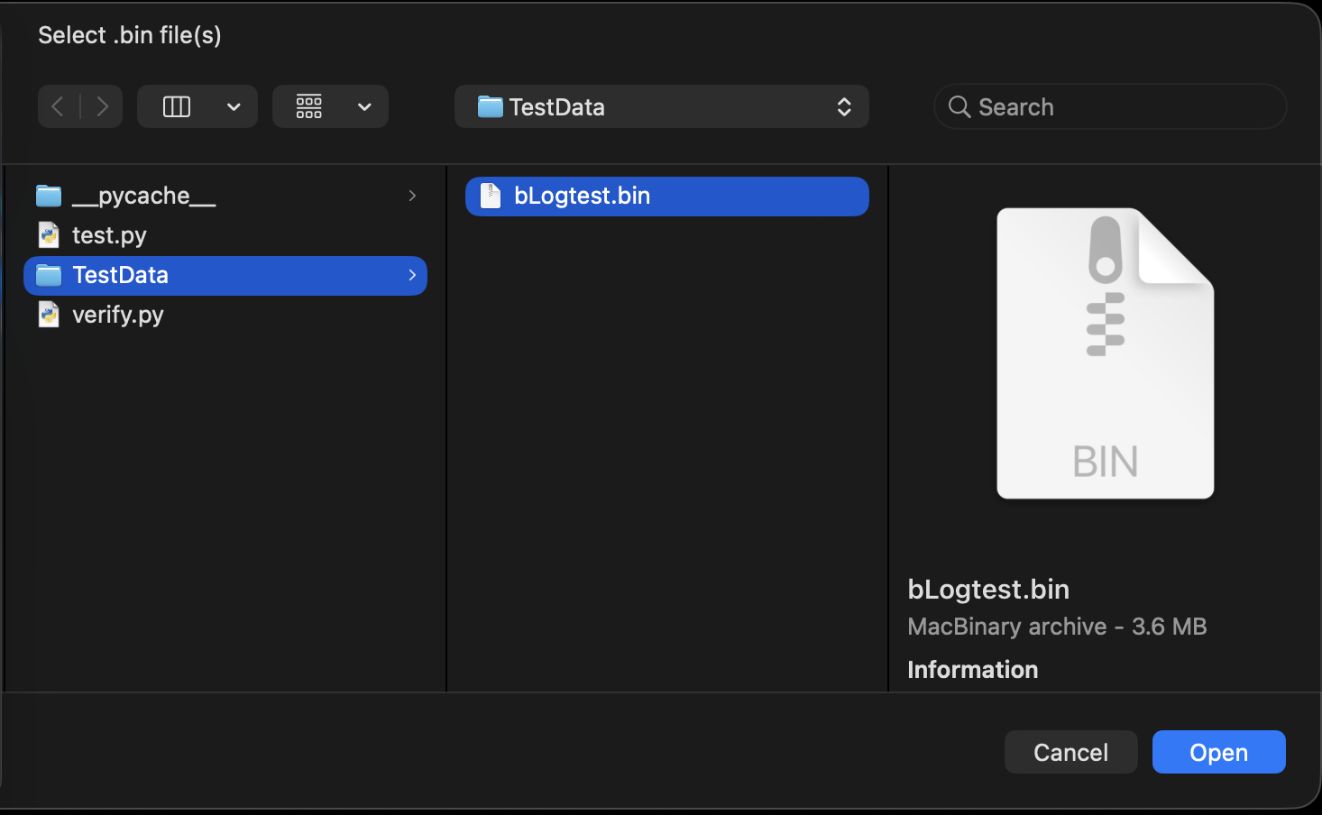
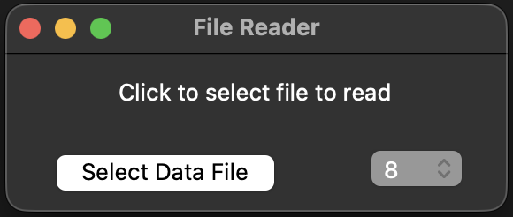

Slide 25
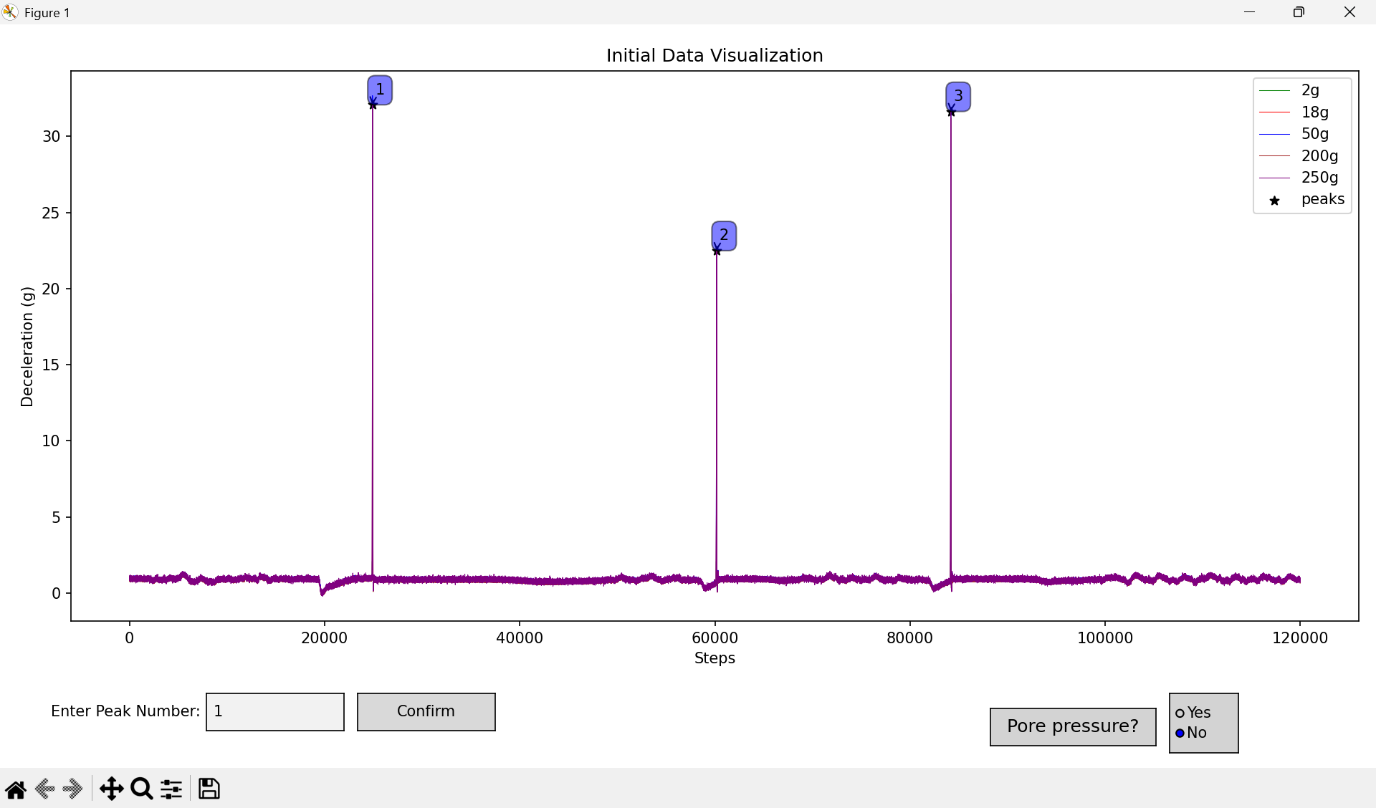

Slide 26
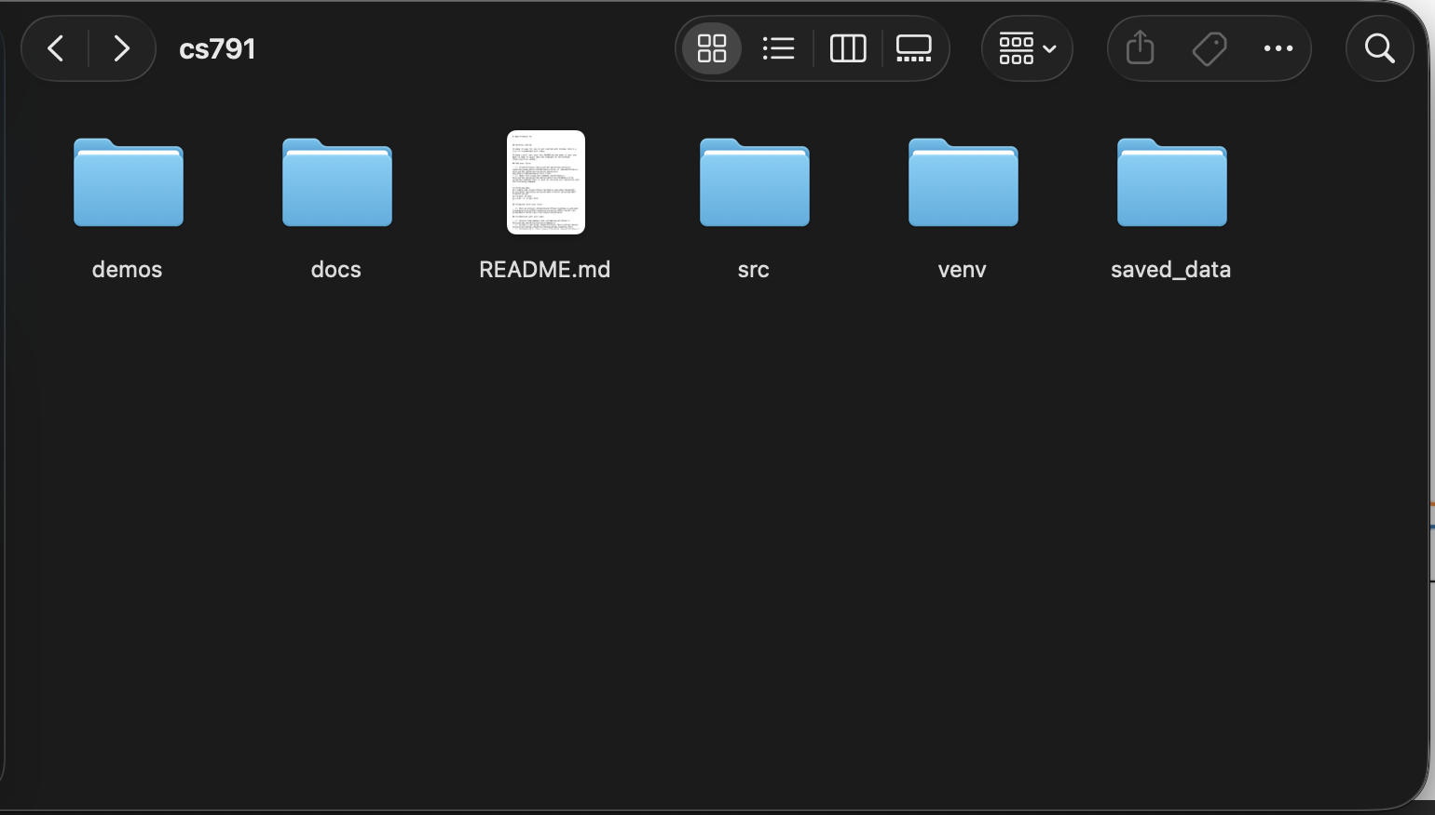
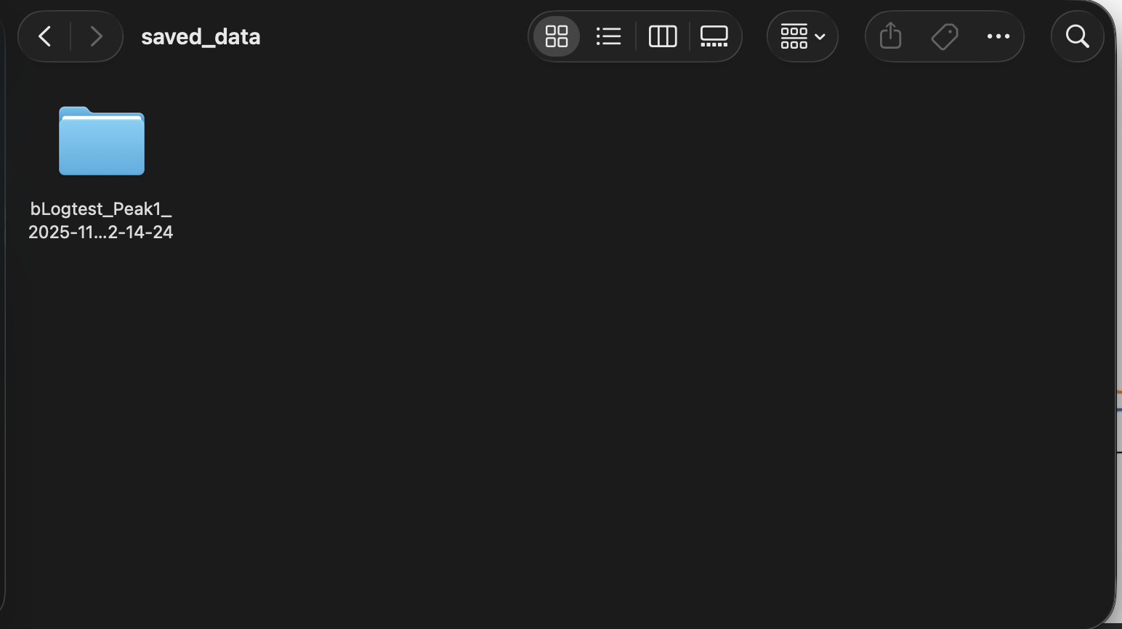

Slide 27
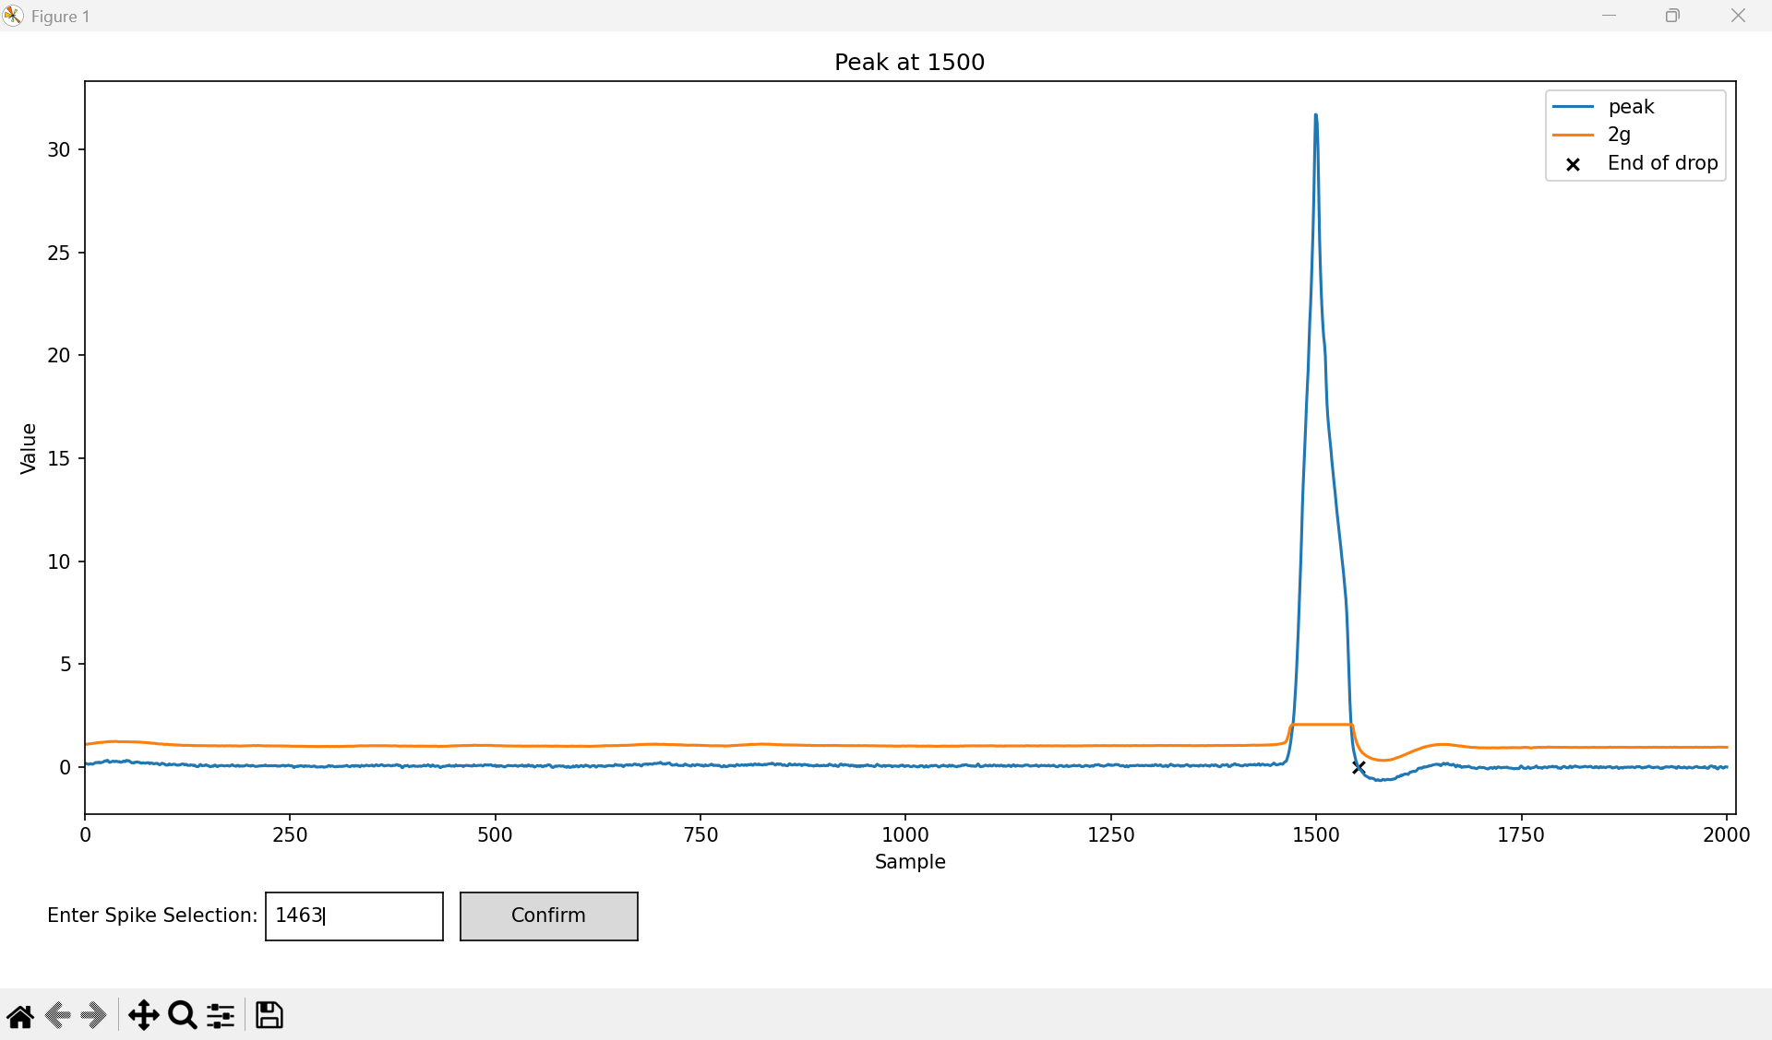

Slide 28
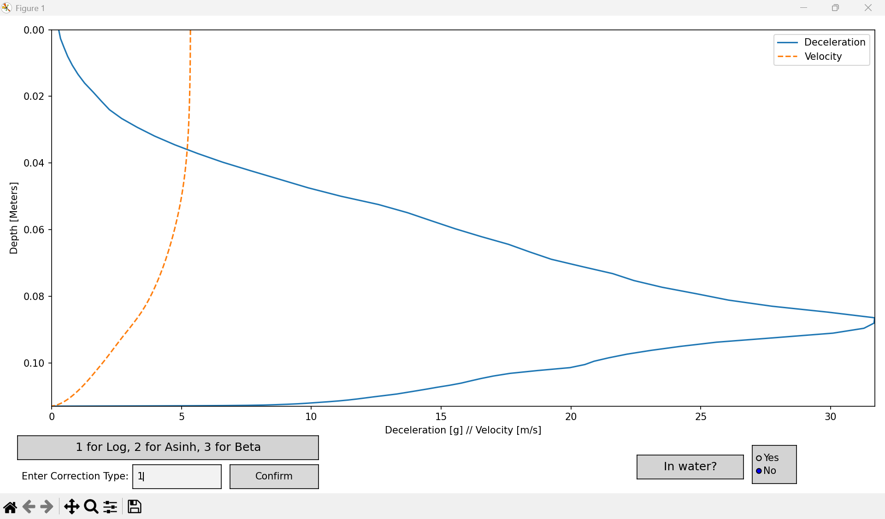

Slide 29
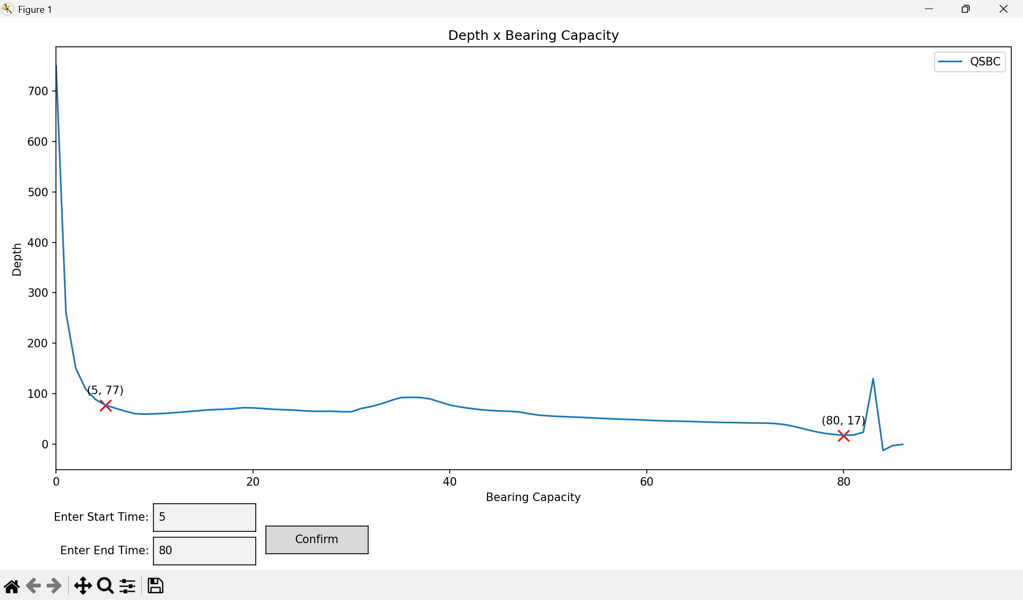

Slide 30
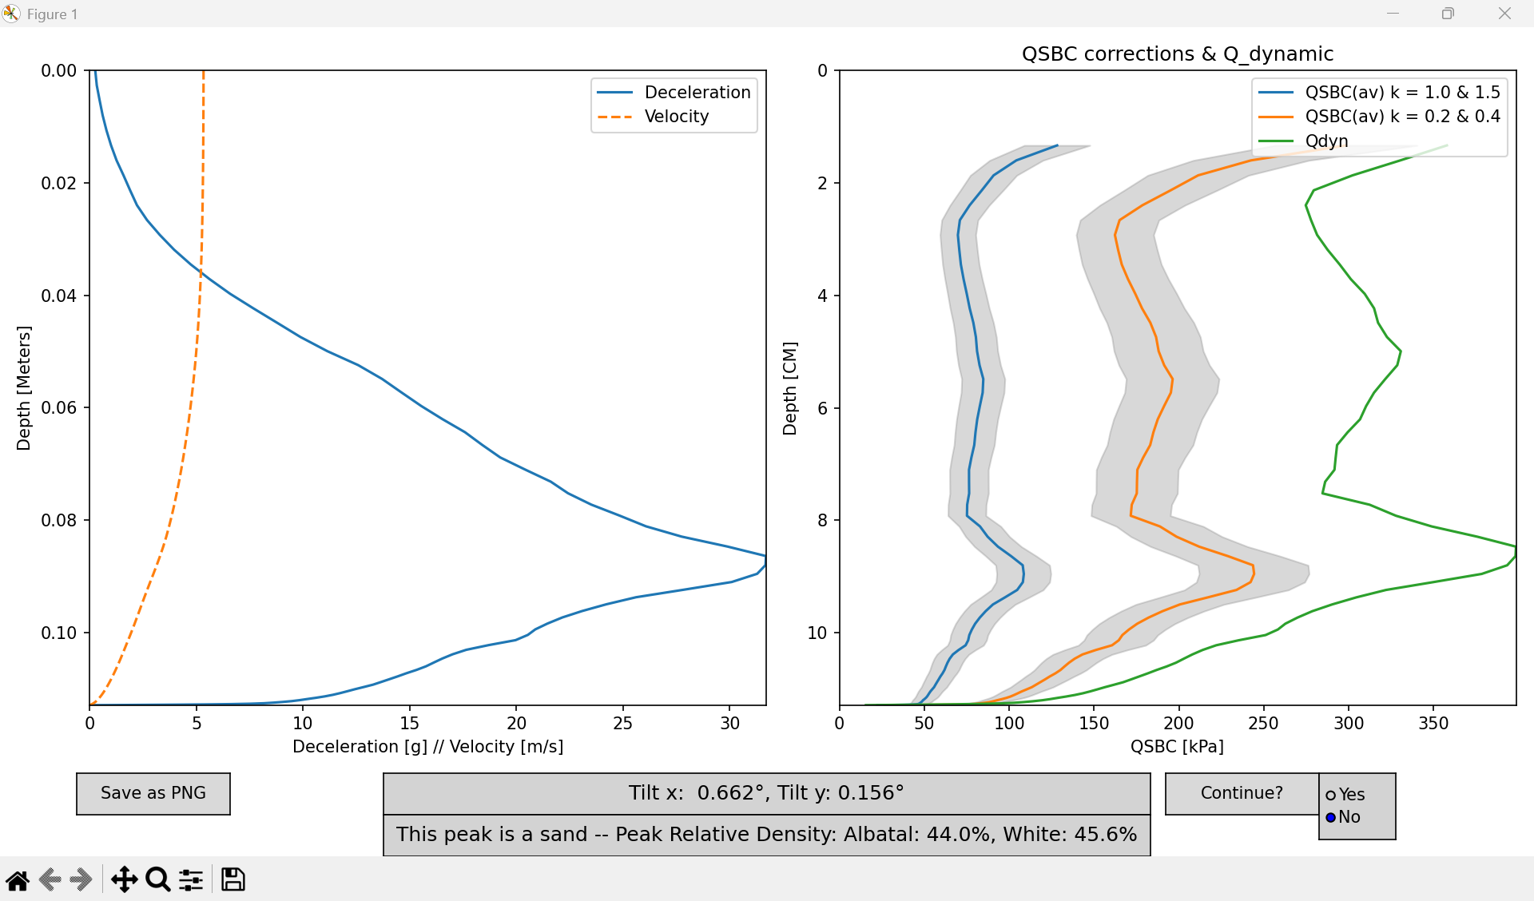

Slide 31
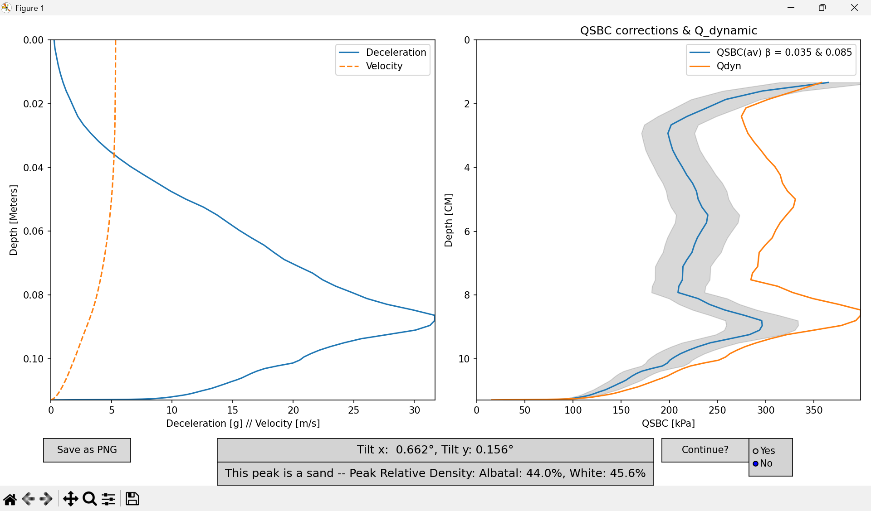

Slide 32
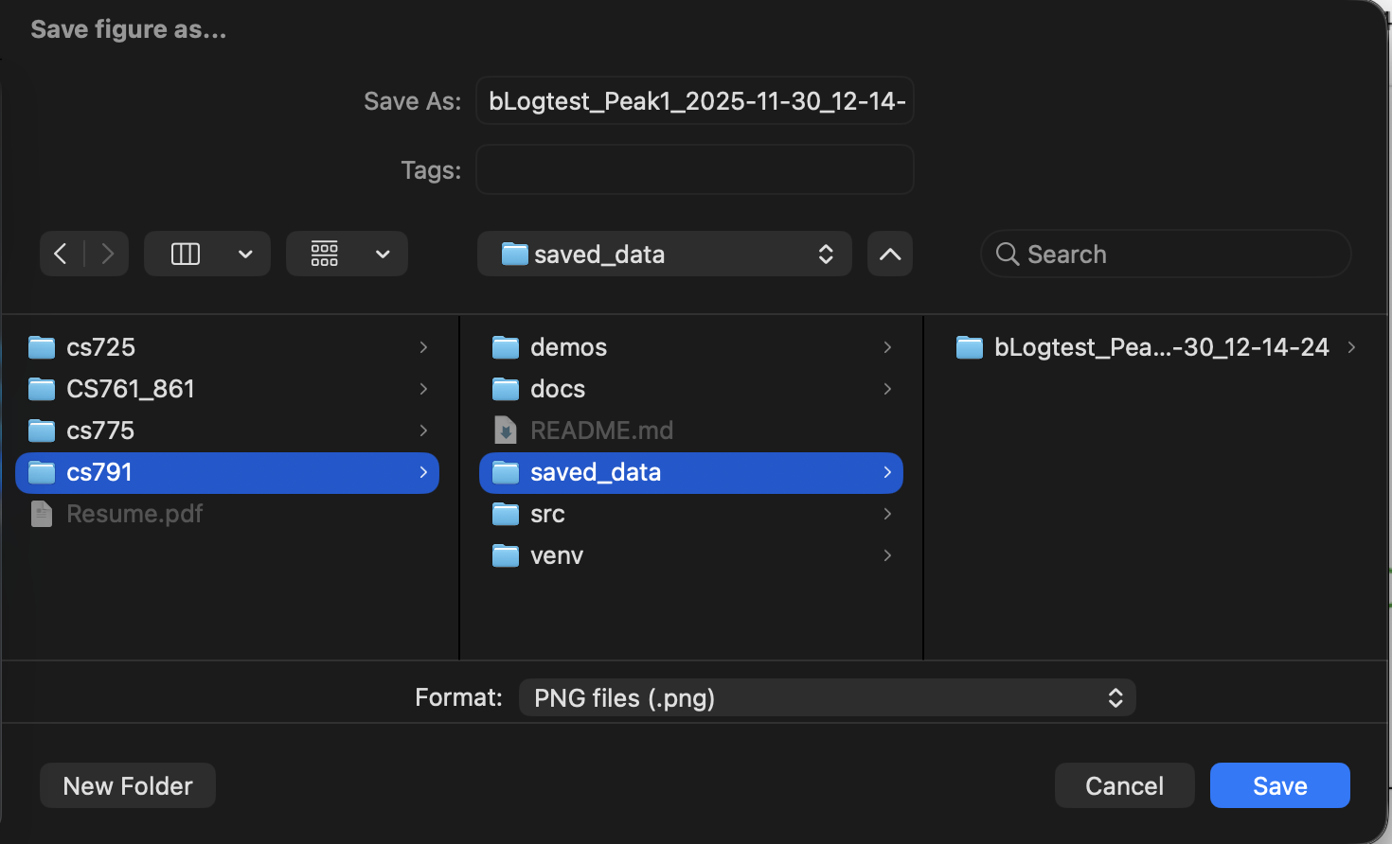
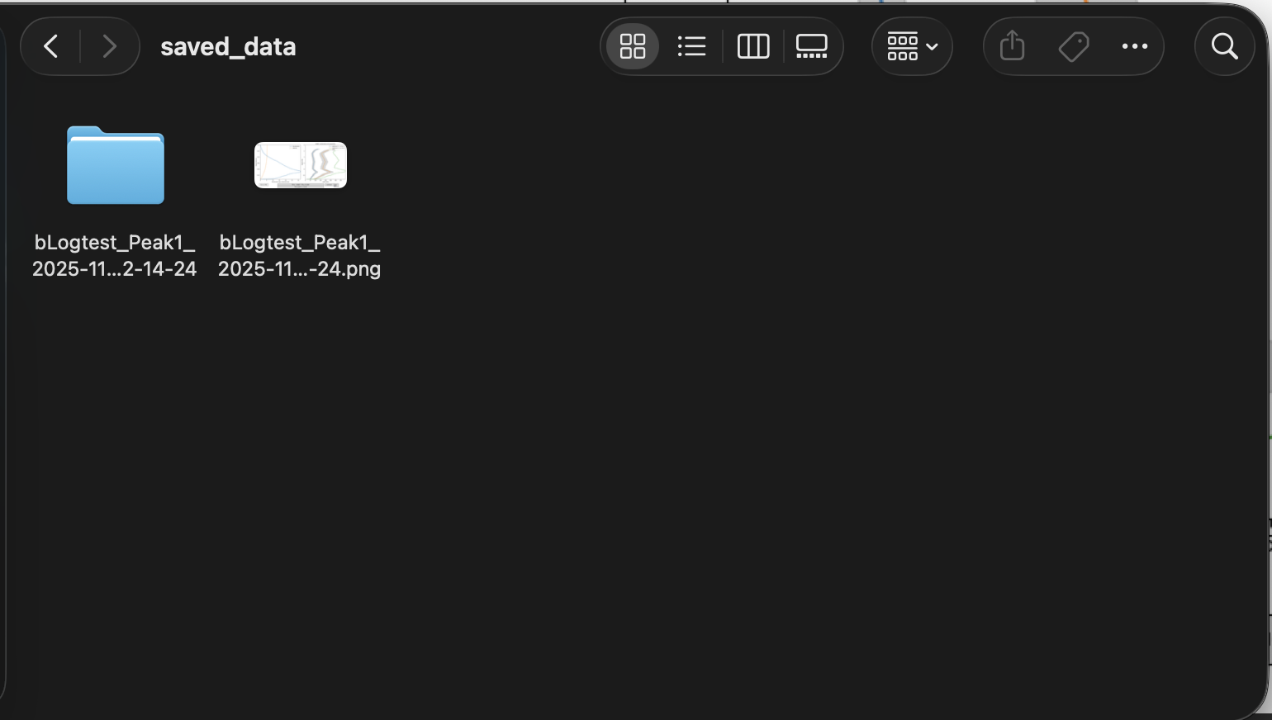

Slide 33
Evaluation and Conclusion

Slide 34
Evaluation
We have met our semester one goal of completing our MVP
Vision
Improve upon and add new features to the existing UI of the Free Fall Penetrometer Processing application.
Success Criteria
Take input and accurately output the two relative density calculations
Improve UI to ease navigation and use
Use relative density calculations for soil classifications

Slide 35
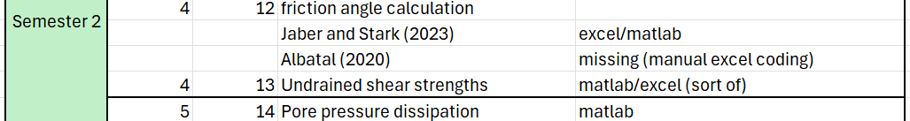
Conclusion
We have a clear path to continue our work in the spring
Discussed with sponsor how we can maximize our value
We will accomplish this by:
Implementing friction angle calculation
Adding pore pressure properties
Allowing the user to input variables for use in relative density calculation

Slide 36
Thank you!
Questions?

Slide 37
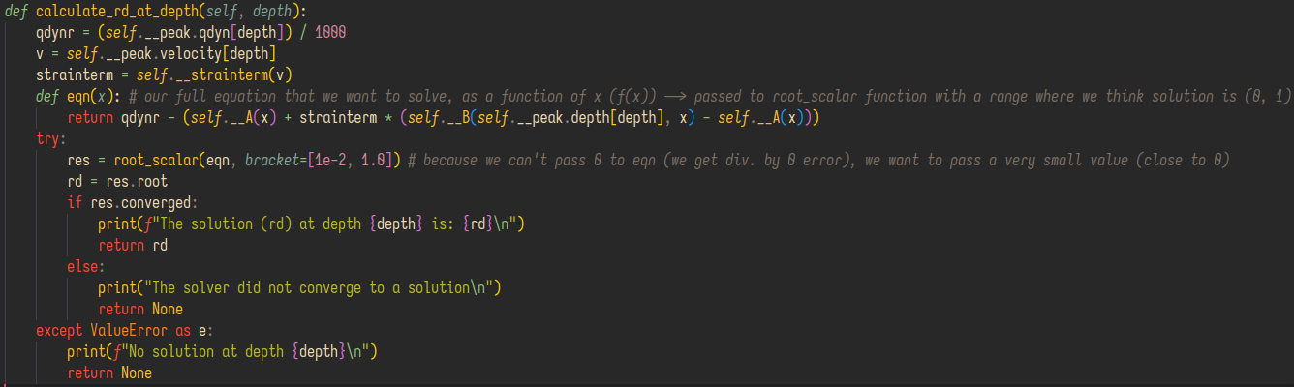
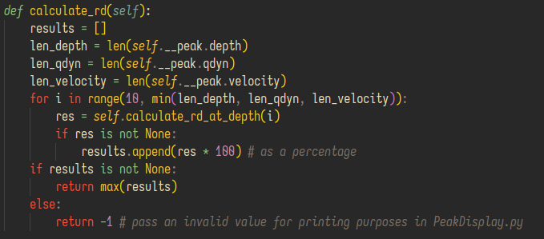
Bonus! Relative Density Implementation – WhiteDensity "snippet"

